Slide 1
Reactive Extensions
(RXJava & RXAndroid)
The prescription your app needs
Jake Wilson
Twitter @JakeWilson801

Slide 2
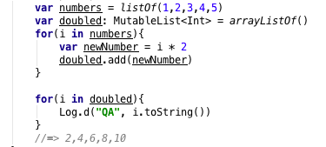
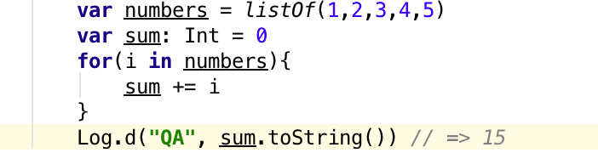
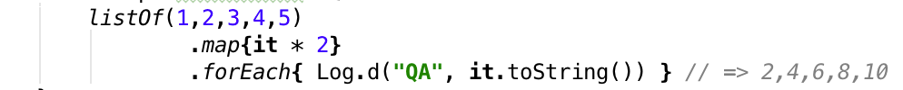
Declarative versus Imperative Programming
Imperative: Use statements to control the programs state. Think Java, C
Declarative: program that describes what computation should be performed and not how to compute it. Think SQL, Regular Expressions

Slide 3
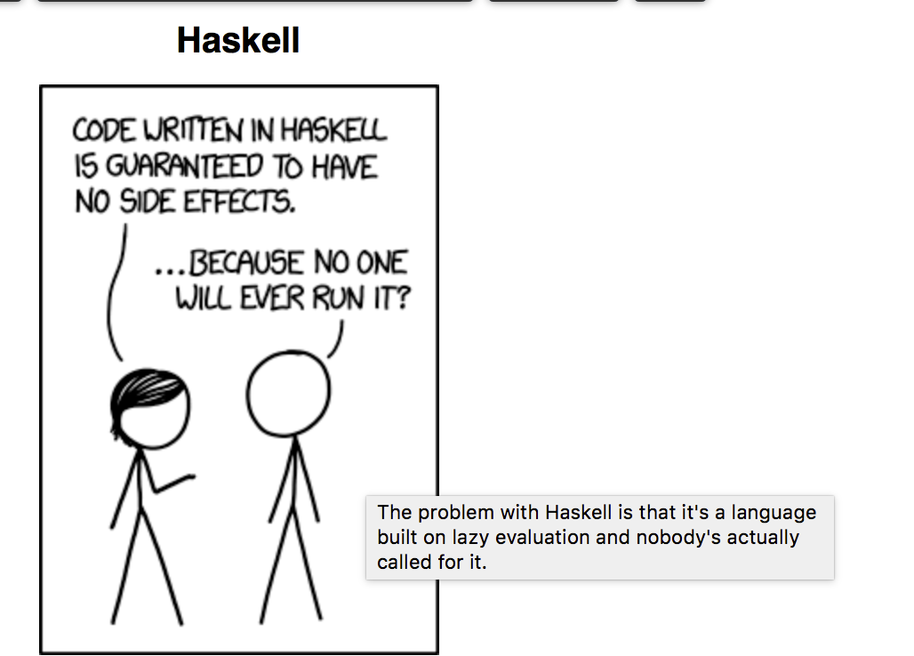
Functional trade offs
New/Old idea
Most schools don't teach it
High barrier to entry
"Pure" functional languages
Elm
Haskell

Slide 4
Functional Reactive Programming
Reactive programming is is programming with asynchronous data streams
Think event buses and click events on steroids
Imagine each element in your Twitter feed was a click event

Slide 5
Why not just use an Event Bus?
The answer is you can!
This medicine has worse side effects though.
Event buses are generally global to the application
NOOO Global variables are bad!
No clear relationship between event producer and consumer
More state and side effects to manage

Slide 6
Don't forget about futures...
Straightforward for single level of asynchronous execution
Nesting adds complexity(prior to Java 8 CompletableFuture).
Difficult to use Futures to optimally compose conditional async execution flows
Error prone, can block on
Only produces single scalar values

Slide 7
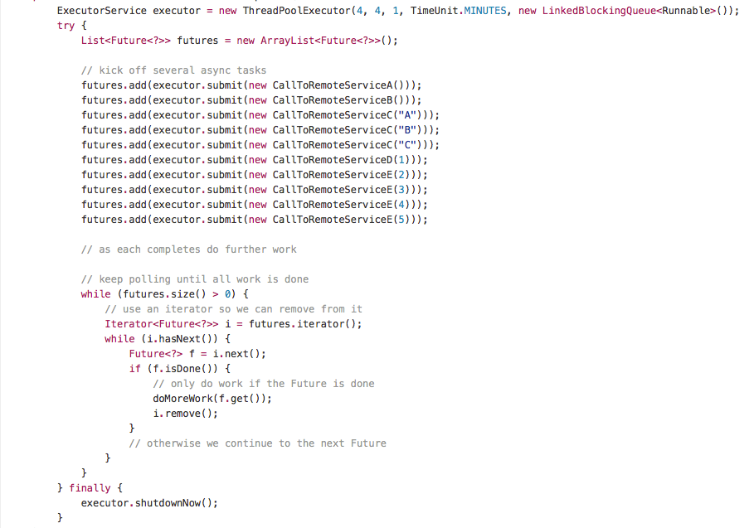

Slide 8
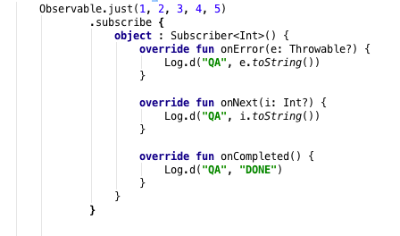
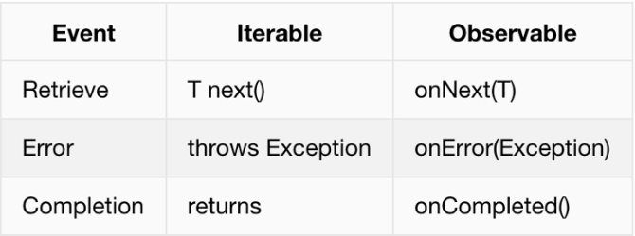
Observer Contract
Think of Iterables in Java. Difference is iterables are pull-based and Rx observables are push-based

Slide 9
Higher Order functions
Transforming
Combining
delay
map
scan
debounce
combineLatest
concat
merge
startWith
zip
Filtering
filter
find
first
last
distinct
Math
Boolean
average
sum
max
min
reduce
sum
every
some
includes
sequenceEqual

Slide 10
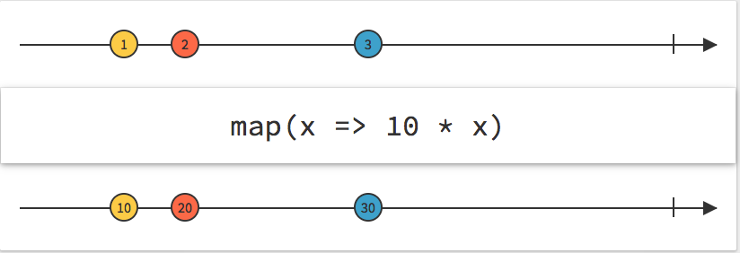
Map

Slide 11
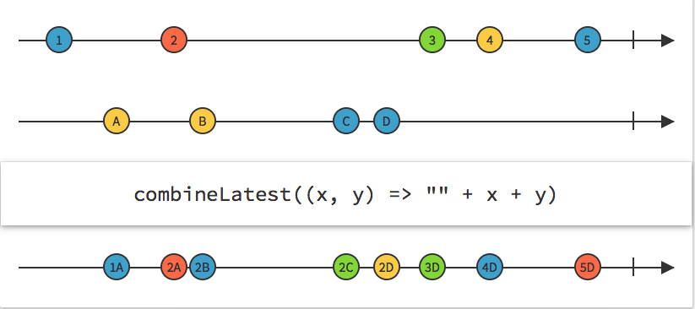
Combine Latest

Slide 12
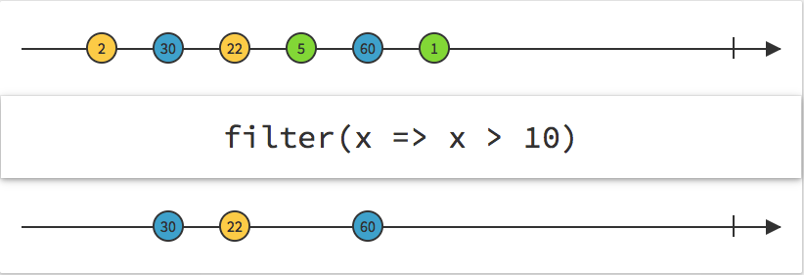
Filter

Slide 13
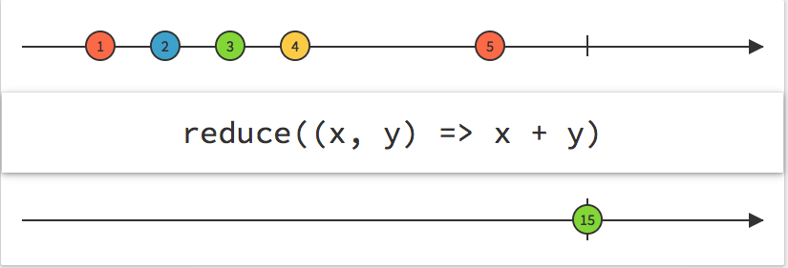
Reduce

Slide 14
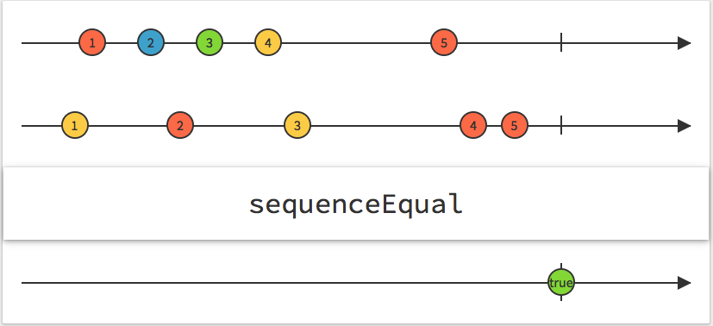
Sequence Equal

Slide 15
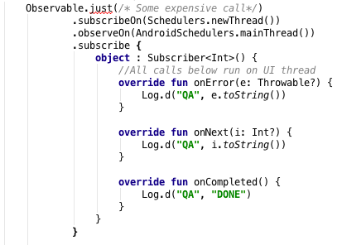
Concurrency
Most of us have had the dreaded NetworkOnMainThread exception
Async Tasks suck, Retrofit's .enqueue works?
Schedulers provide a simple way to manage which threads do the heavy lifting and which run on the UI

Slide 16
Where RX shines
https://github.com/dustin-graham/RxAndroid-Sample/blob/master/app/src/main/java/com/example/rxandroid/ImperativeWageCalculatorActivity.java
https://github.com/dustin-graham/RxAndroid-Sample/blob/master/app/src/main/java/com/example/rxandroid/ReactiveWageCalculatorActivity.java

Slide 17
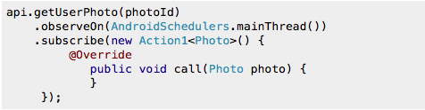

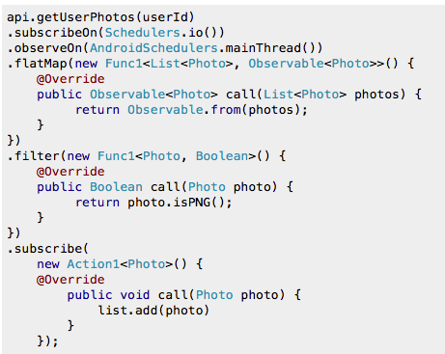
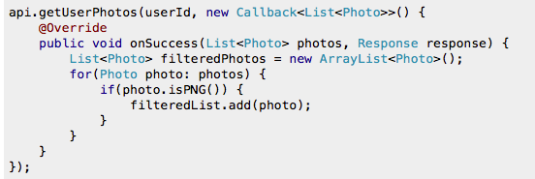
Where RX Shines
RX
Callbacks

Slide 18
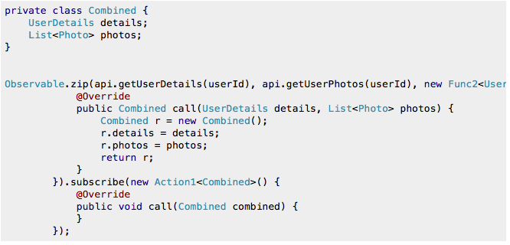
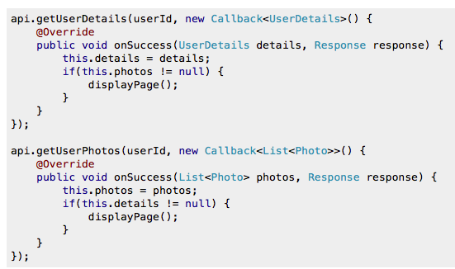
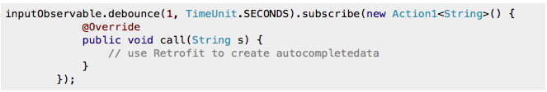
Where RX Shines
RX
Callback

Slide 19
Questions?

